Slide 1
The State of Youth Engagement in the United States
Felicia M. Sullivan, Ph.D.
Senior Researcher
NC State University Institute for Emerging Issues
#YouthEngageNC Summit
Friday, November 6, 2015

Slide 2
A little bit about CIRCLE
The nation’s premier institution devoted to studying what makes young people into active and responsible citizens.
Conduct Research and Evaluation
Making Connections…Connecting the research world with policy and practice
Supporting a Research Field
Notes:
CIRCLE is based at the Jonathan M. Tisch College of Citizenship and Public Service at Tufts University. Serving every student at Tufts University, Tisch College prepares young people to be lifelong active citizens and creates an enduring culture of active citizenship

Slide 3
Who are these Millenials?
There is a big market for praise
and blame

Slide 4
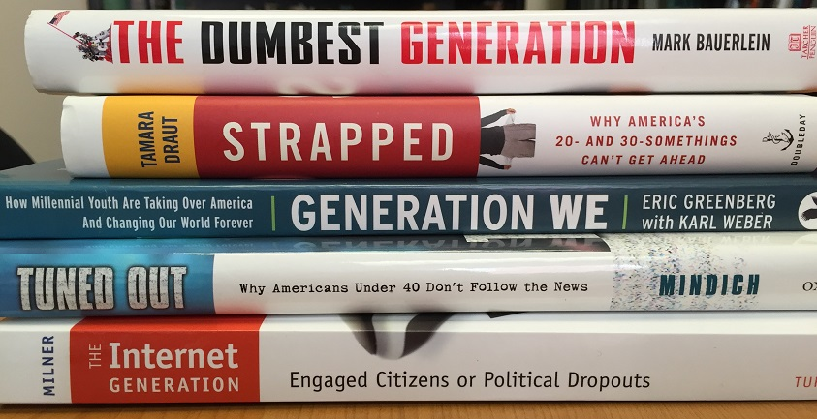
What is the solution?

Slide 5
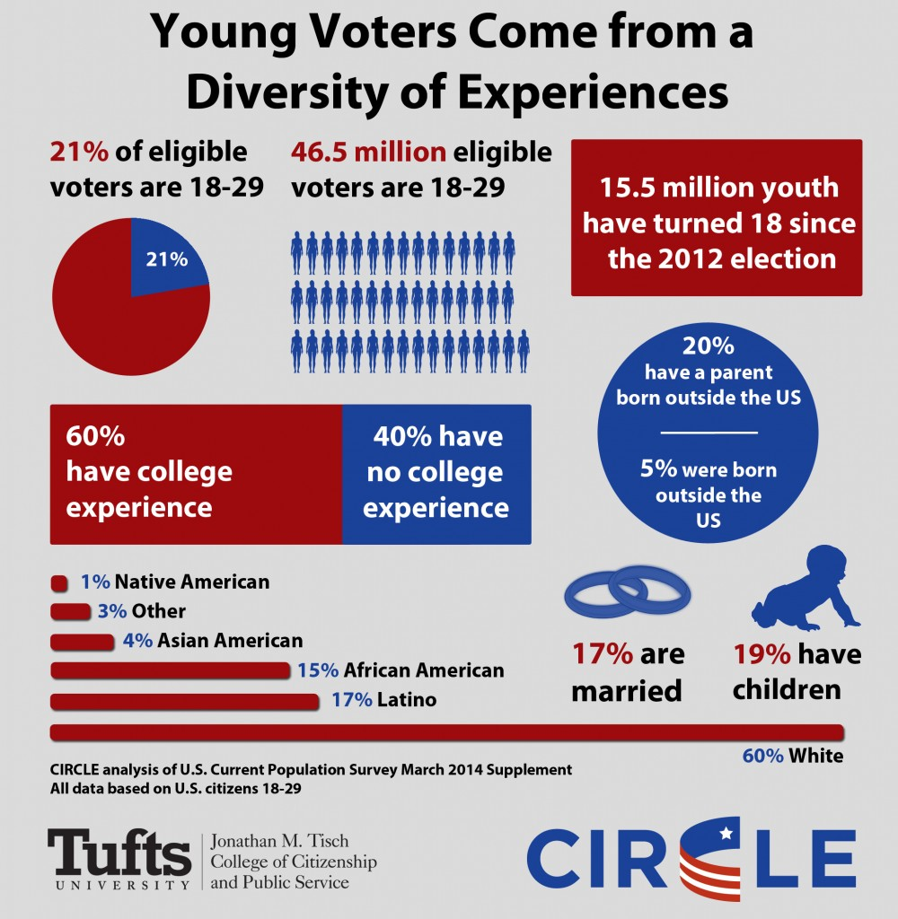
Actually, they are strikingly diverse ….
Notes:
Demographics
2014 Current Population Survey National
47 million young people
ages 18-29 years old are eligible to vote
43 million seniors ages 65 and older are eligible to vote
Just 10% of Americans between 18 and 24 met a standard of “informed engagement”
Less than half of youth (18-29) voted in 2012
Polarization
Risk to civics curriculum
Barrier to controversial discussions and political education
24.8% of teachers thought that parents or other adults would object if politics was discussed in their government course
Data on 6,913 people
Including 720 teachers, stakeholders, and young people
Information on all 51 state laws
Civic life is moving online
Digital citizenship
Potential for lowering the barriers
Inequality
Unequal opportunity
Widening gap?
White, wealthy students are 4-6 times more likely to exceed “proficient” in civics
7% of low-SES students reached “proficient.”
By the time young women are 18-29 years old, there many gaps related to politics: Interest Gap, Confidence Gap, Expectations Gap, Race and Class Gaps, Assessment Gap,
At the same time that young 18-29 year old women are more likely to participate in many ways such as volunteering and community service, they are less likely to participate in politics. And we know the level of women’s representation in elected office.
Education
Move away from the civic mission of education More time and efforts on reading and math Dependence on high-stakes tests Workforce readiness = individual skills and knowledge

Slide 6
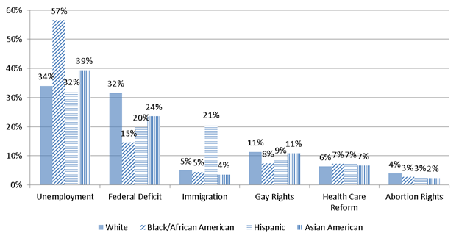
Their issue priorities vary . . .
Source: CIRCLE’s 2012 Commission for Youth Voting and Civic Knowledge Survey

Slide 7
How they engage varies . . .

Slide 8
2010 Engagement Patterns of Youth (18-29) Some College Experience
Source: CIRCLE report “Understanding a Diverse Generation: Youth Civic Engagement in the United States”, November 2011.

Slide 9
2010 Engagement Patterns of Youth (18-29) No College Experience
Civically Alienated
Source: CIRCLE report “Understanding a Diverse Generation: Youth Civic Engagement in the United States”, November 2011.
Notes:
Definition of civically alienated??

Slide 10
Why is engagement important?
Individual
Increases likelihood for engagement later in life
Combination of education and civic learning is related to higher college completion rates
Community
More stakeholders with applicable experience working on issues
Economic resilience

Slide 11
So let’s look a bit more closely . . .

Slide 12
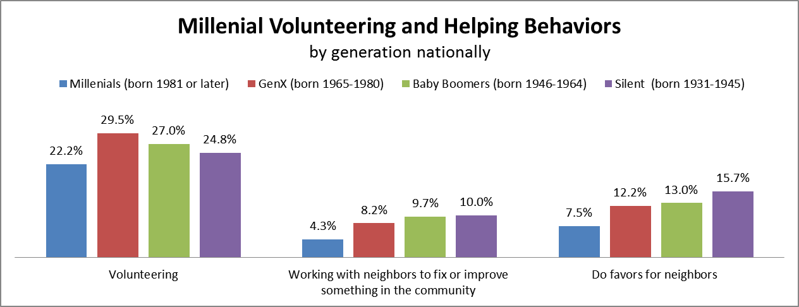
Source: CIRCLE analysis of 2013 CPS Volunteering and Civic Engagement Supp.

Slide 13
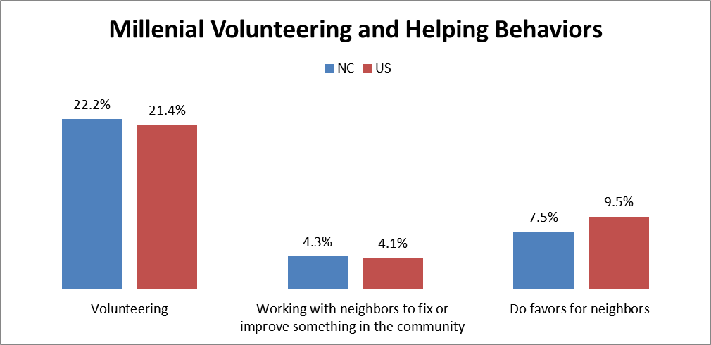
Source: CIRCLE analysis of 2013 CPS Volunteering and Civic Engagement Supp.

Slide 14
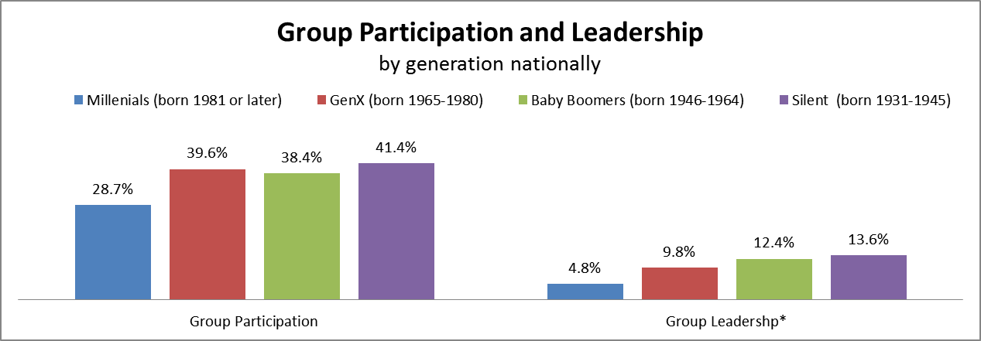
Source: CIRCLE analysis of 2013 CPS Civic Engagement Supp.

Slide 15
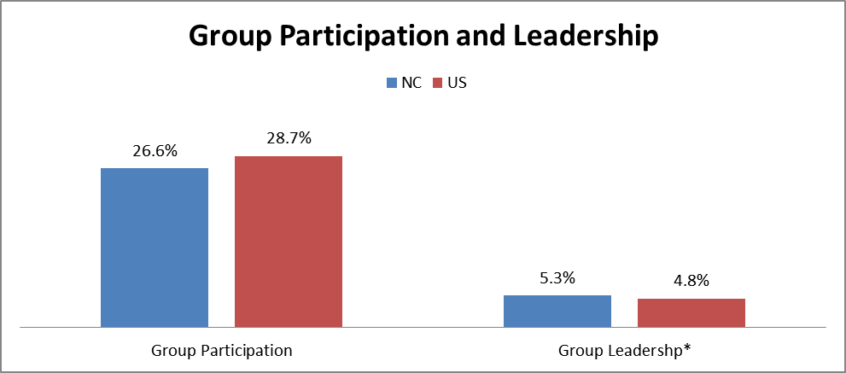
Source: CIRCLE analysis of 2013 CPS Civic Engagement Supp.

Slide 16
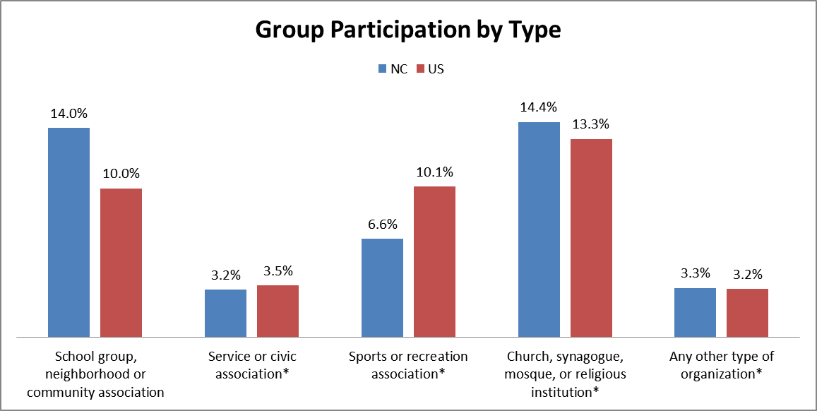
Source: CIRCLE analysis of 2013 CPS Civic Engagement Supp.

Slide 17
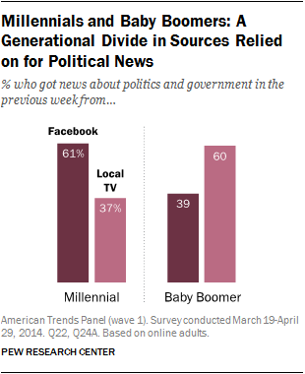
Notes:
Millennials rely on Facebook for their news far more than any other source.
Compared with the previous two generations, Millennials are less familiar with many news sources we asked about in the survey
Millennials are no less trusting than Gen Xers and Baby Boomers of news sources they know.
Millennial Facebook users are exposed to more political content on the social media site than are Gen Xers or Boomers.
Differences by race – Whites more likely to use to support social life; African Americans more likley to use to support political efforts or intersts
Millennials are less interested in politics than older generations – . This is not, however, unique to their generation – 18- to 29-year-olds have historically been less interested than their elders in news about politics.

Slide 18
Youth engagement with social media & communication tools
89% of use social networking sites
67% use mobile devices (e.g. phones) to access social media
49% use messaging apps like WhatsApp, Kik or iMessage
20-23% use online discussion forms or Tumblr
Source: Pew Research Center, January 2014 Social Media Factsheet and 2015 Mobile Messaging and Social Media
Notes:
18-29 year olds - higher percentage of this age group use these tools than other age groups
Not enough to just broadcast information to them – enlist them to want to share and engage with contetn
http://www.pewinternet.org/fact-sheets/social-networking-fact-sheet/
http://www.pewinternet.org/2015/08/19/mobile-messaging-and-social-media-2015-main-findings/

Slide 19
How do we engage young people?

Slide 20
Suggestions from Young People
Interactive and engaging activities, discussion, especially about issues that the youth identify with
Learning and developing practical skills that will help transition into adulthood, as well as participate in civic life
More opportunities to work with young people in their community
Source: CIRCLE “That’s Not Democracy . . How Out-of-School Youth Engage in Civic Life & What Stands in Their Way “ – August 2012

Slide 21
Suggestions from Research
Build trust through consistency
Civic skills are deep learning skills
Build on current engagement
Notes:
Trust - Emphasize strong, authentic and caring relationships with adults and trusted organizations especially
Skills - Make links with civic education – especially high-quality learning opportunities that build – communication, critical thinking, experiential, -- college and career
Current engage – go to where the youth are at and start where they are starting
in NC – schools, community / neighborhood / nonprofit orgs, faith-based groups, then sports and recreation, online, in their social lifes

Slide 22
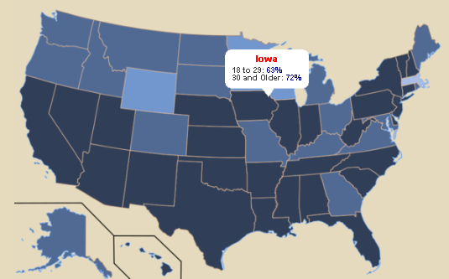
CIRCLE Resources
Find fact sheets, interactive map, and more at the CIRCLE website: www.civicyouth.org
Contact CIRCLE staff with questions or requests

Slide 23
Stay informed
Sign up for e-Updates on our website:
Follow us on social media:
facebook.com/civicyouth
@civicyouth

